Slide 1
Summer School Reset
Dr. Kimberly Higgins, Ms. Deb Pidsadnick, Mr. Dan Souder, and Mrs. Sarah Wood
Pioneer Middle School

Slide 2
Introductions
Dr. Kimberly Higgins
Ms. Debra Pidsadnick
Mr. Dan Souder
Mrs. Sarah Wood

Slide 3
Background
Why we teach summer school
11 Month
Notes:
Explain 11 month eligibility and that building principal decides how the teachers’ time is used.
Teaching summer school is required of all middle school staff this year.

Slide 4
How summer school use to look
3 weeks
3 hours a day
Each student took 3 classes (ELA, Math, Study Skills)
Each class was 55 minutes long with a 5 minute transition
Each middle school 11 month teacher was assigned a grade level and a class
Pass/Fail Grade for each subject

Slide 5
Potential Problems
Students who passed math and ELA, but failed science, social studies, or LOTE were required to come even though science, social studies, or LOTE were not addressed.
There were more teachers than spots to fill, therefore some teachers were assigned to secondary roles in the classrooms.
Teachers have various certifications.

Slide 6
The Change
After eligibility for the 11 month this year, there were 16 middle school teachers who qualified
This allowed for 4 teachers per grade level

Slide 7
The Plan
Summer School Proposal for students currently in 8th grade moving to 9th grade
Teachers- Kim Higgins, Deb Pidsadnick, Dan Souder, and Sarah Wood
Overview of proposal- The above four teachers will analyze, customize, and execute educational plans for each individual student in the summer school program at the 8th-9th grade level. All four teachers will teach in a double room for the 3 hours students are in attendance providing specific instruction to the academic need(s) the student requires. This will be accomplished through various methods including: large group instruction, small group instruction, individual instruction, station work, and various co-teaching methods.
Assessment- Goals will be set by teachers and the individual students in regards to the appropriate achievable goal in area(s) of weakness with a 3-week time frame, as well as appropriate assessment to determine success in achieving the goal(s).
Assessment of Program- The four teachers along with the summer school principal will meet at the end of summer school to go over student goals, student work, and the ending assessment. Also, a survey will be done with the students as an exit strategy out of the summer school program. All data will be analyzed to determine the successes and weaknesses of the program so that the program can be modified if necessary.
Research- The positive impact of summer school is greater when the program is relatively small and when instruction is individualized. According to the research, the various components of effective and high quality summer programs include offering small class sizes, providing differentiated and high quality instruction, hiring experienced and trained teachers, providing individualized learning, grounding learning in a real-world contexts, aligning summer curriculum with school year curriculum, implementing curriculum that complements curricular standards, providing engaging learning activities, integrating hands-on activities, offering sufficient duration of instruction, conducting program evaluation, and providing accessible summer school, especially for disadvantaged youth(Almus & Dogan, 2016).

Slide 8
Successful Summer School Programs….
have small class sizes
provide differentiated and high quality instruction
hire experienced and trained teachers
provide individualized learning
ground learning in a real-world context
align summer curriculum with school year curriculum
implement curriculum that complements curricular standards
provide engaging learning activities
integrate hands-on activities
offer sufficient duration of instruction
conduct program evaluation
provide access to summer school, especially for disadvantaged youth

Slide 9
Where the idea came from
Chuck Schwan and Bea McGarvey’s book Inevitable
“We need to meet our learners at their levels - based on their learning styles - challenge them and support them in achieving success at school each day. This is the "ideal” learning experience.”

Slide 10
Process
Once we received the potential list of summer school students we created a sheet based on the individual needs of each student.

Slide 11
Student Name_____________________________
ELA score:
D1:
D2:
D3:
Math score:
D1:
D2:
D3:
Science score:
D1:
D2:
D3:
Social Studies score:
D1:
D2:
D3:
World Language score:
Notes:
Objectives:

Slide 12
Student A- Tommy
ELA- 50 D1- Reading level 2 grade levels below (fluency and comprehension) D2- Writing in complete sentences
Math- 50 D1- fractions D2- decimalsD3- word problem
Social Studies- 65
Science- 67
World Language- exempt
Tommy has trouble being organized. He also has trouble paying attention for extended periods. He does not like to do long extended projects.
Objectives: Have Tommy read at current grade level he is scoring at fluently and try to improve that score. Have him read an appropriate short story for his reading level, answer comprehensive questions correctly. Have him read an appropriate article of his choice topic, and write a complete summary about it.
Tommy will take a fraction and decimal pre-test and post-test, and increase his decimal and fraction competency by 50%. Tommy will be able to correctly answer a word problem using decimal and fraction operations. He will also create word problems with easier operations in them.
Tommy will work on organization skills that will be helpful to him in high school.

Slide 13
Scheduling
As the students participation was confirmed, we talked to their former teachers regarding the deficits and what areas we should work on.
Social studies agreed that we should pre-teach Global as that is a tough subject for many of the students coming into grade 9.
As we looked at math deficits, it was decided to separate the group into three sections by ability.
ELA deficits were handled individually
Most students did fairly well in science, it was homework completion that was the problem

Slide 14
Other additions
Career project
Budgeting
Reading
Proofreading/editing
Calculator Use

Slide 15
Scheduling
Teachers were assigned a mentor group
Grouping of “mass classes” was determined by ability and personality
Mass classes were scheduled first, then small group and individual classes
10 minute module blocks were used so students could be blocked into 10, 20 or 30 minute sections.

Slide 17
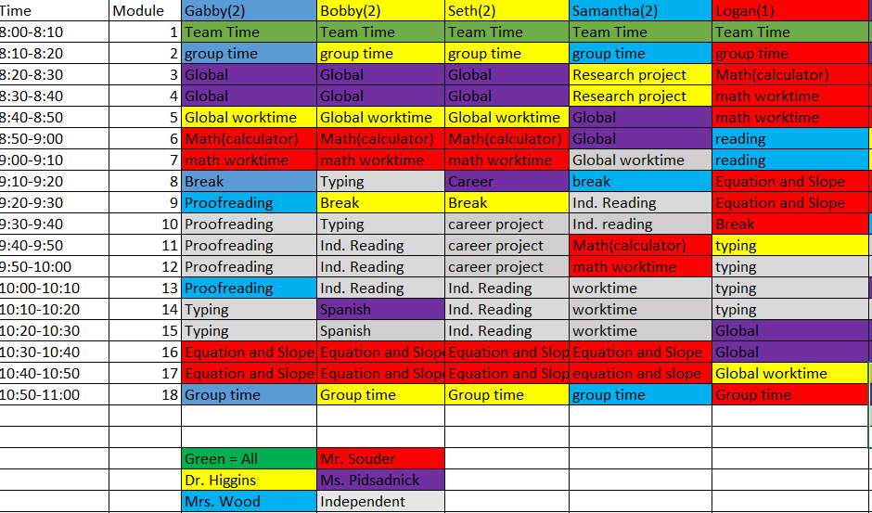

Slide 18
Teamwork
On a daily basis the team would reflect after the students went home to be able to adjust scheduling and/or instruction. The team would also address personal issues of students with administration so as to make sure the lines of communication remained open.
No students were in need of administrative disciplinary action for the 3 week period.

Slide 19
Results
A series of 7 questions were asked of the students who were in summer school the last week of the program.

Slide 21
How many times have you attended summer school in Middle School?

Slide 22
Did you like the new Summer School Format?
All 15 students said YES!

Slide 23
Why did you like the new format?
Day goes faster
More worktime, less instruction
More separation from peers
Move around and don’t have to sit for 45 minutes
Shorter time and smaller groups
More hands-on
Move more

Slide 24
Would you rather do summer school online?
Six students said, “Yes” (one of those did admit they probably wouldn’t get things done though)
9 students said, “no” due to lack of accountability, no wifi, and the fact that they like face- to- face instruction

Slide 25
How could you have avoided having to come to summer school?
Do homework
Better attendance
Caring more about school
Being in class (and not in office)
Participating
Studying for tests

Slide 26
Did summer school give you any help for starting 9th grade?
Every students answered, “yes”
Pre-teaching Global and Math were key
Being able to tour and be in the HS building also helped

Slide 27
What goals do you have for yourself next year?
Pass
At least 70’s in all classes
Merit Role
Homework plan
Take advantage of help
Attendance
Pay attention in class

Slide 28
One month results
We purposefully tracked four of the summer students into their first 5 weeks of High School.
Of the four students chosen, two are regular education, and two are special education

Slide 29
Student 1- Julius
Julius is a regular education student
In 8th grade, he failed math, science, and French
Passed ELA, but with a low grade

Slide 30
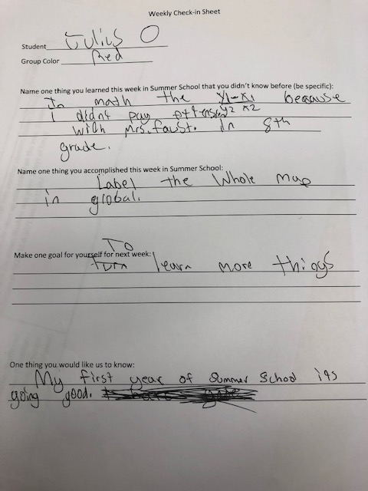

Slide 31
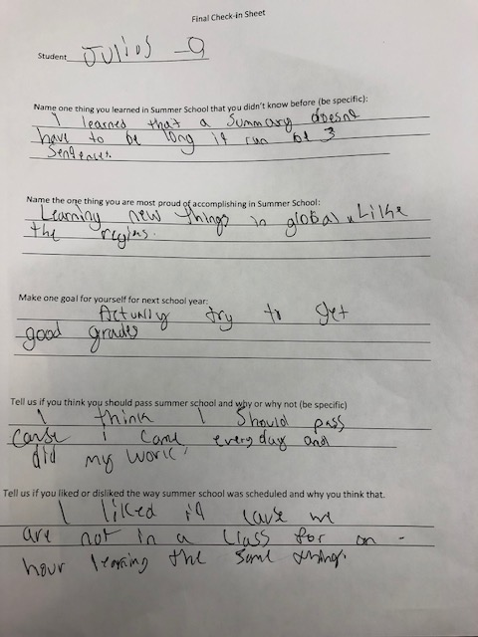

Slide 32
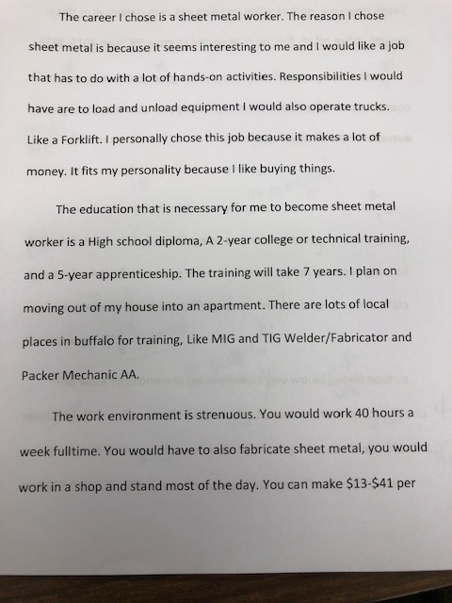

Slide 33
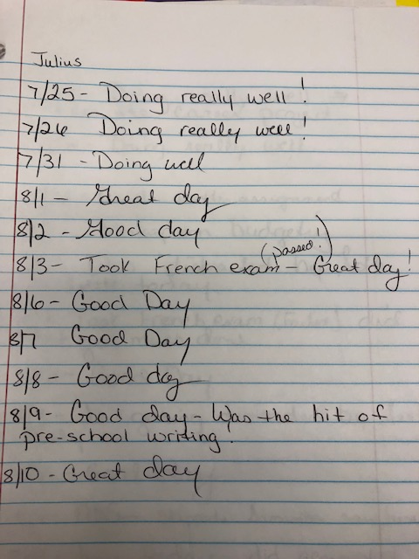

Slide 34
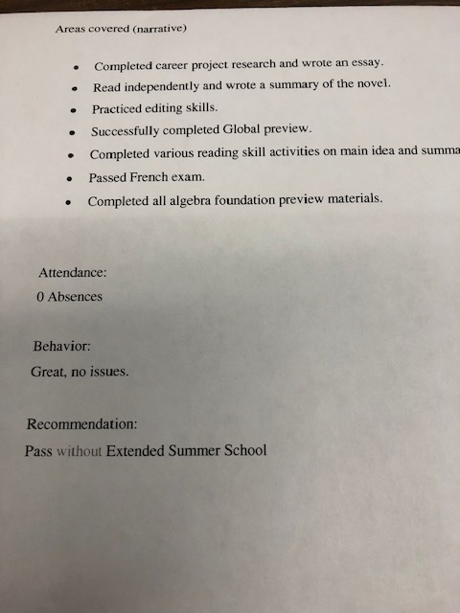

Slide 35
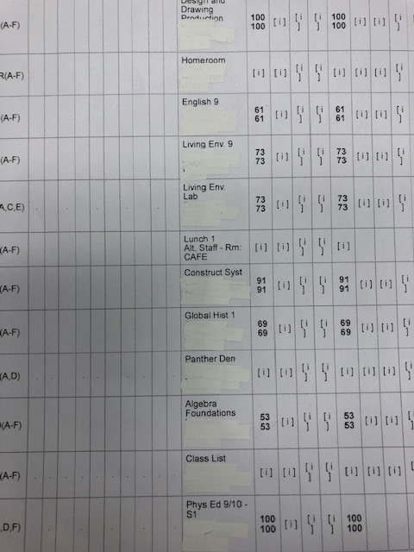

Slide 36
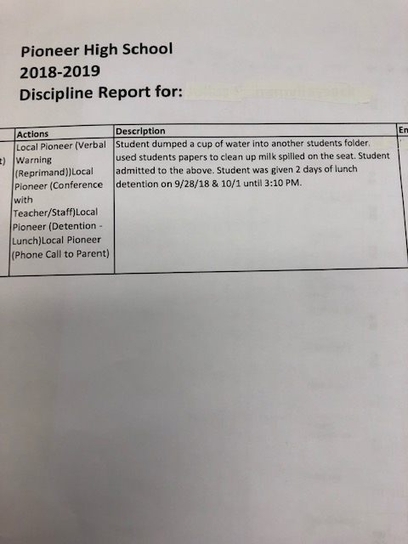

Slide 37
Student 2- Gabby
Gabby is a regular education student
Gabby has a 504 plan and receives a resource study hall
Gabby failed math, social studies, science, and Spanish
Gabby had frequent absences

Slide 38
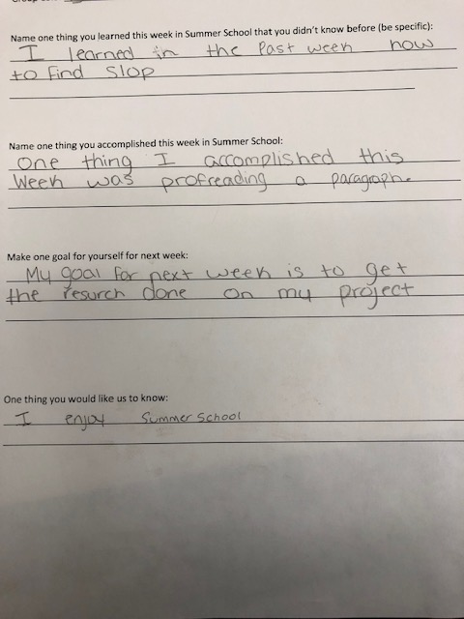

Slide 39
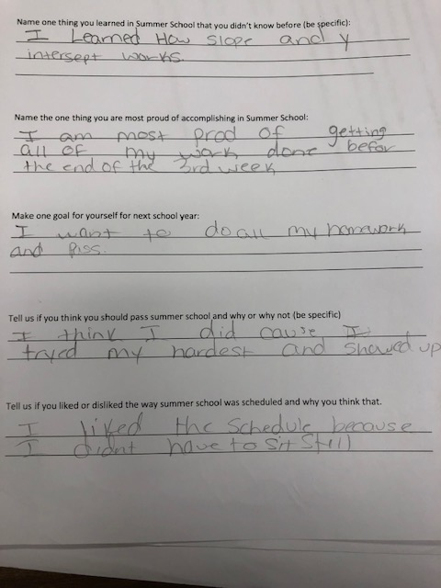

Slide 40
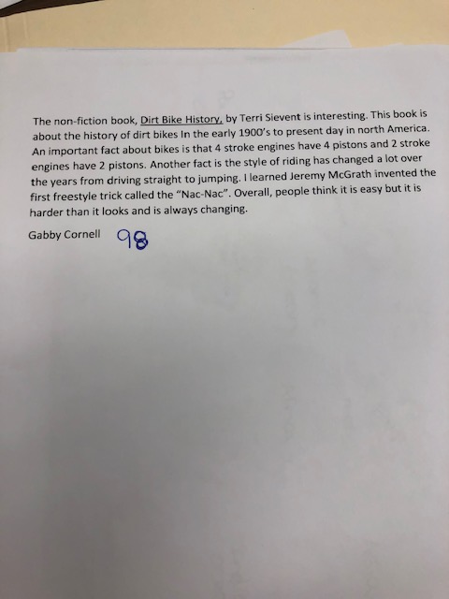

Slide 41
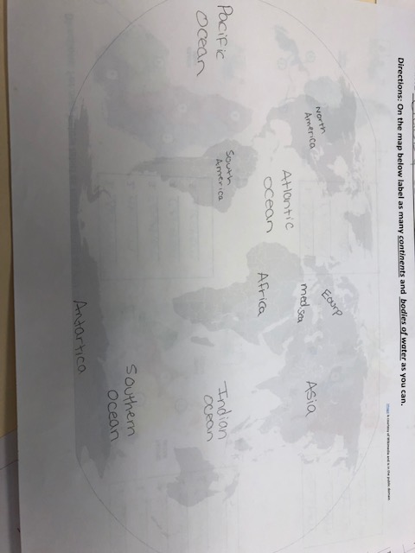

Slide 42
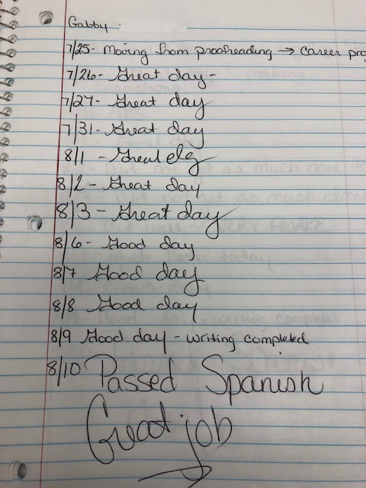

Slide 43
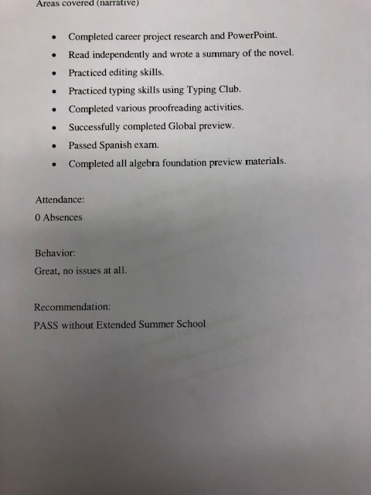

Slide 44
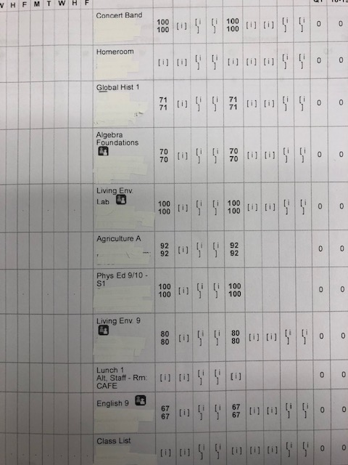

Slide 45
Student 3- Bobby
Bobby is a special education student in a 15:1 classroom
He takes regular electives
He failed math and Spanish

Slide 46
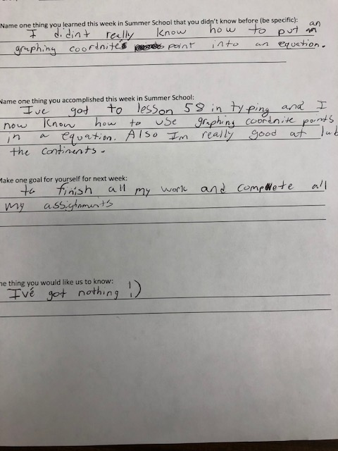

Slide 47
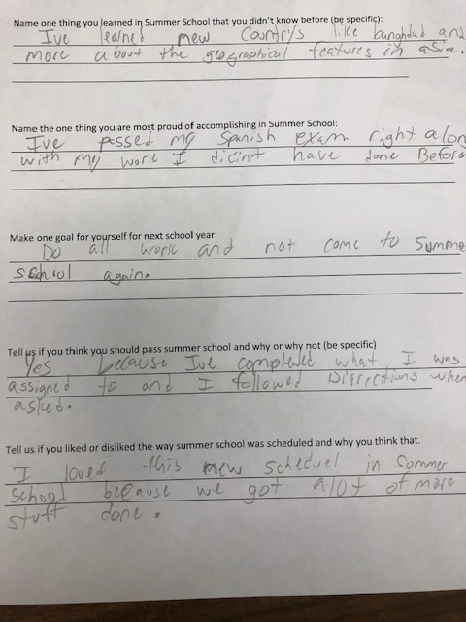

Slide 48
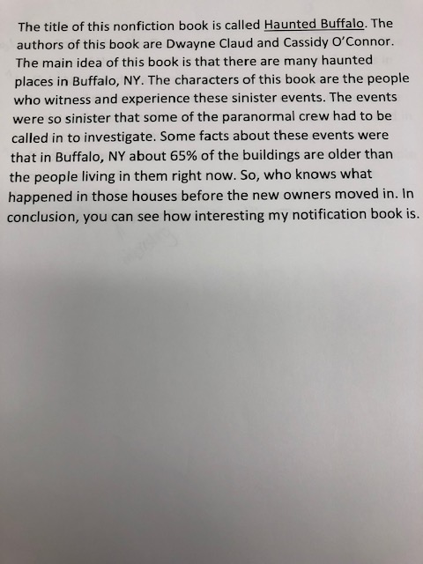

Slide 49
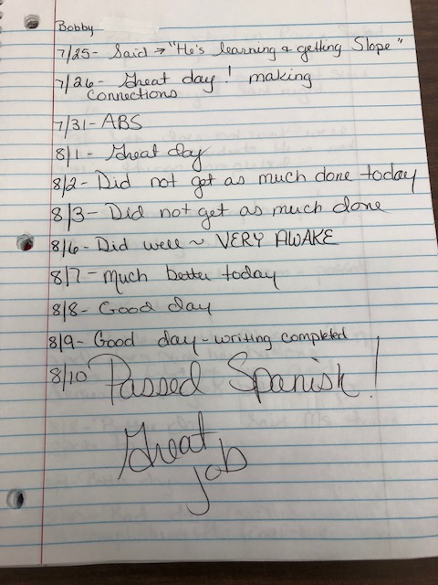

Slide 50
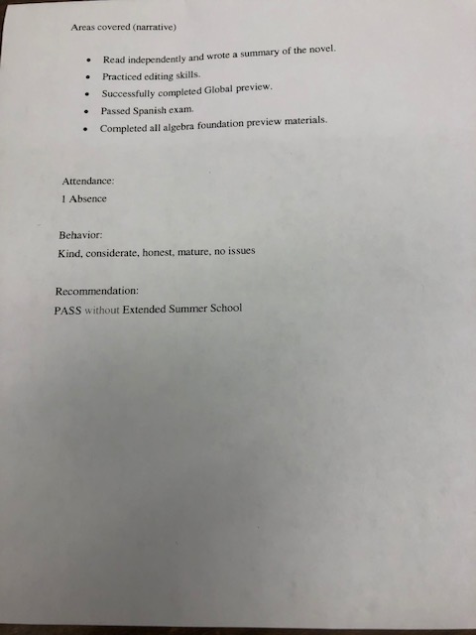

Slide 51
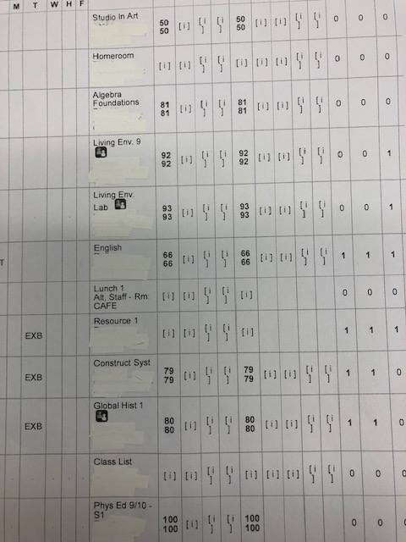

Slide 52
Student 4- Cameron
Cameron is a special Education student in a 15:1 setting
Cameron is now in the Panther Project program in High School
He failed ELA, math, social studies, and science
Foreign Language exempt
Multiple discipline referrals

Slide 53
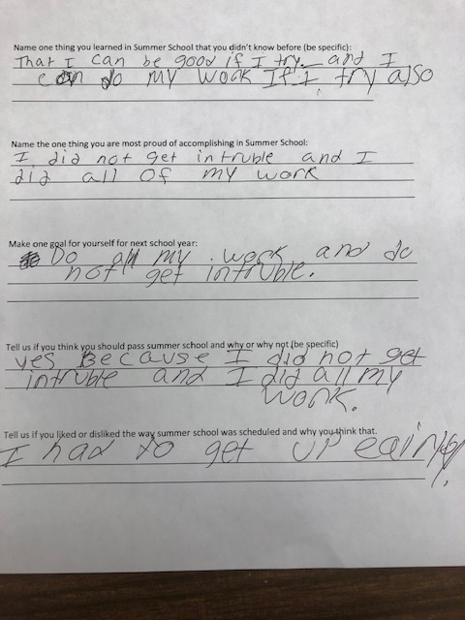

Slide 54
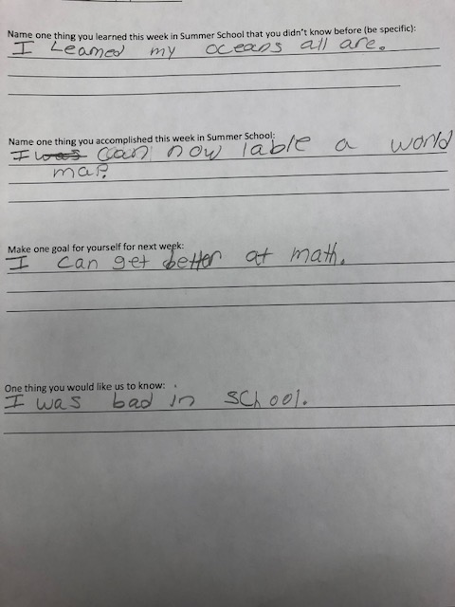

Slide 56
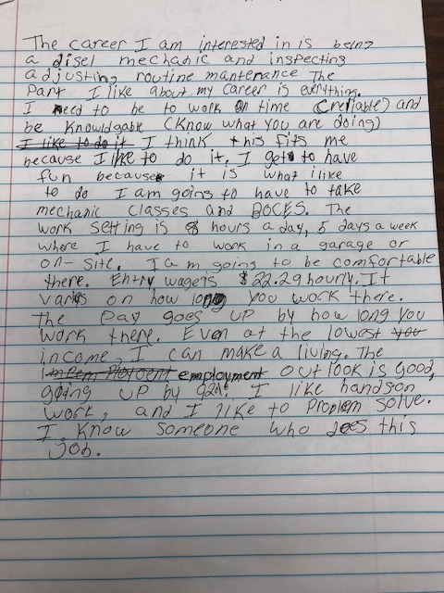

Slide 57
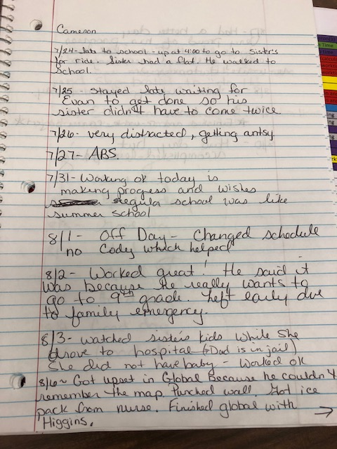

Slide 58
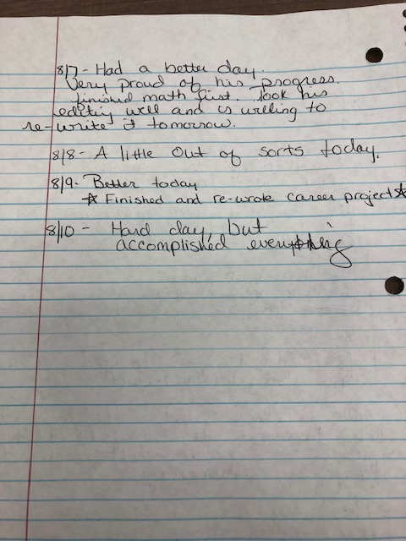

Slide 59
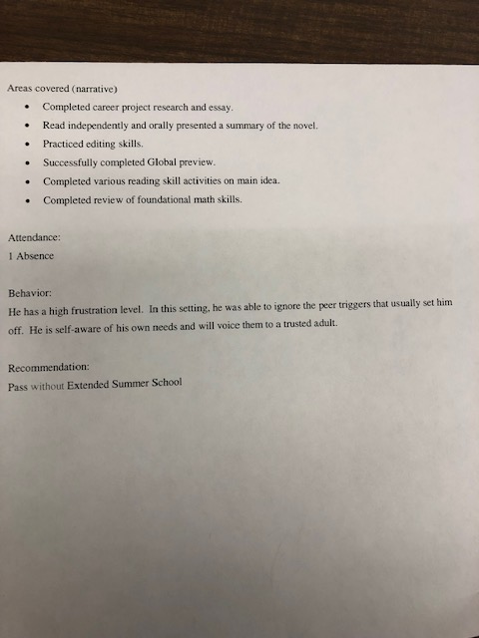

Slide 60
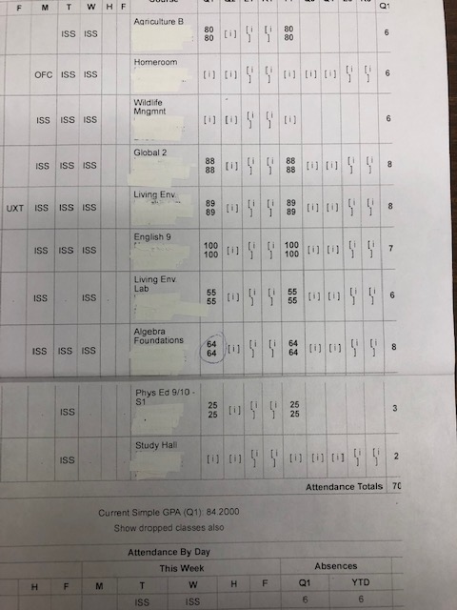

Slide 61
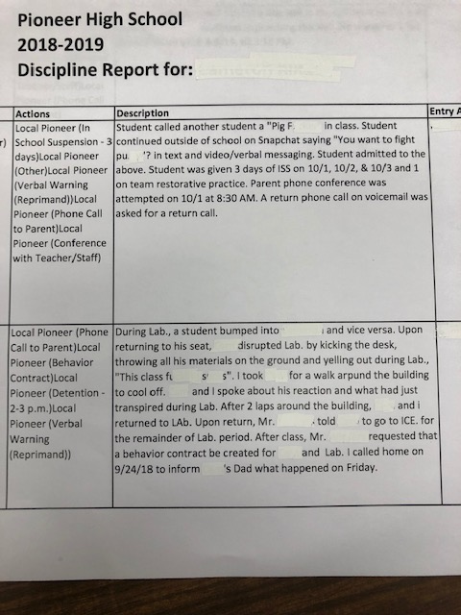

Slide 62
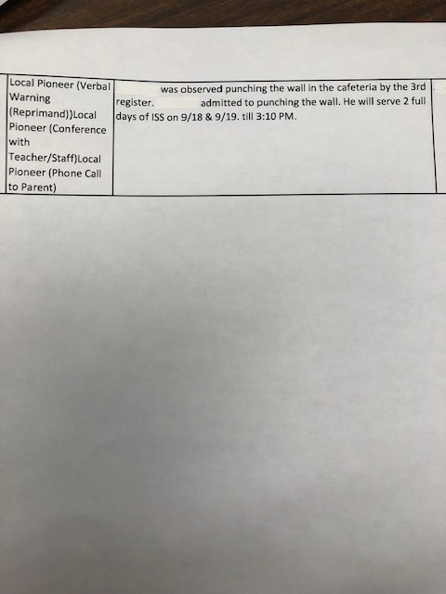

Slide 63
Changes for next year
Retain same basic program with modifications to ELA and math as reflected by student needs
Pre-teach Global
Possibly add pre-teaching of a science unit
Add a budgeting class

Slide 64
QUESTIONS

