Slide 1
Welcome to Our Webinar! Please say hello in the chat window. Where do you teach?
OMG! I'm Teaching in the Middle Grades. What Now?!

Slide 2
Our Focus: Teaching & learning in grades 4-8
• We seek out resources and create original content for teachers, school leaders, parents & others committed to the success of young adolescents.
• Visit MiddleWeb.com for middle grades interviews, guest articles, resource roundups & book reviews.
•And subscribe to the twice-weekly MiddleWeb SmartBrief to keep up with the latest 4-8 news. • Find out how you can write and review for MiddleWeb at our Get Involved page: http://bit.ly/mw-involve
@MiddleWeb on Twitter and MiddleWeb Resources at FB

Slide 3
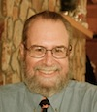
Our Moderators
Sheryl Nussbaum-Beach, a former upper elementary teacher and technology coach, is CEO of Powerful Learning Practice LCC. She's the author of The Connected Educator: Leading and Learning in a Digital Age and an international consultant on issues of 21st century learning.
John Croft Norton is the founder and co-editor of MiddleWeb, co-founder of the national Teacher Leaders Network, and an education writer/editor.
Susan B. Curtis is co-editor of MiddleWeb and a former middle and high school teacher, human services professional, and reference librarian.

Slide 4
Our Sponsors
Toby Rothstein Gruber is Director of Professional Services for Eye On Education (Heather's publisher) and also moderates EOE's professional development webinars.
Zsofia McMullin is Web Coordinator for Stenhouse (Rick's publisher) and the wrangler for the company's annual summer Blogstitute.

Slide 6
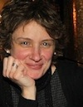
Our Experts
Former Disney TOY and sought-after middle grades teaching expert Rick Wormeli, author of Meet Me in the Middle and Day One & Beyond: Practical Matters for New Middle-Level Teachers.
Education Week contributor Elizabeth Stein, special education teacher and new-teacher mentor, nationally certified in Literacy, with teaching experience across the grades 4-8 spectrum.
Blogger (TweenTeacher, Edutopia) and 8th grade E/LA teacher Heather Wolpert-Gawron, author of ‘Tween Crayons & Curfews: Tips for Middle School Teachers.

Slide 7
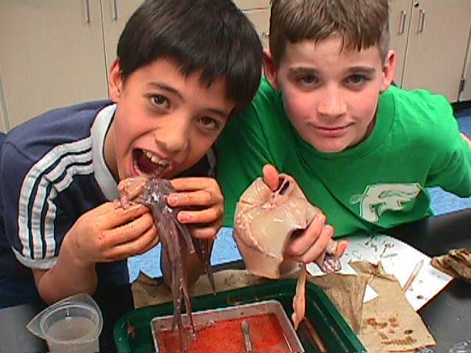
Behavior and Discipline Tenets
for Middle School Teachers
Good discipline begins and is maintained by developmentally appropriate instruction. Be informed and act upon that information.
Good discipline is proactive, interactive, and reactive. It is done with students, not to them.
Middle schools students desperately want to belong, and they are deeply motivated.
Effective teachers honor what students brings to the table; they find a way for students to “save face.”
Effective teachers speak in short sentences; students do more work in the discipline than teachers do.
Consequences must be finite.
Discipline based on fear of the teacher does not work.

Slide 8
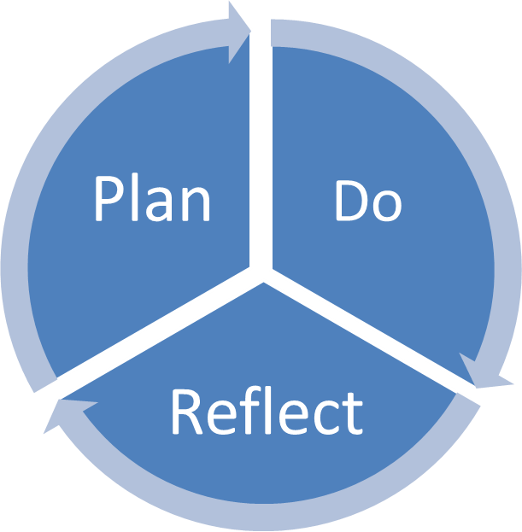
Classroom Procedures & Management Elizabeth Stein, NBCT
Three Steps to Creating a Supportive Classroom Environment:
Plan: Clear objectives, engaging, learner-centered lessons
and structured, consistent procedures
Do: Respond (do not react), provide structure with flexibility
Reflect: Self Questioning Checklist /Be Proactive
Image credit: clarkston.org
Must Dos:
Know your students
Create an environment where students are engaged, active learners
Apply attention grabbing techniques, monitor attention & learning
Implement consistent procedures and consequences
Academically challenge every student
Create a seating chart conducive to deeper learning (don’t be afraid
to shake it up!)
Use Humor (and if you’re not funny—no worries—just be yourself!)
Check it out…
http://www.nea.org/tools/ClassroomManagement.html (general resource)
http://www.nea.org/tools/16256.htm (applying “Accountable Talk” for classroom discussions that can engage and guide all students to learn)
http://www.naset.org/783.0.html (classroom management strategies, differentiated strategies for inclusion, resource room, or self-contained classrooms)
http://www.marilynfriend.com/approaches.htm (co-teaching approaches)

Slide 9
Differentiation in 10 minutes or less!
Heather Wolpert-Gawron

Slide 10
3…2…1…Go!
1. Figure out how YOU learn best
2. Take an informal temperature of the learners in the room
3. Teach to every modality (eventually)
4. Give them chances to learn independently
5. Teach them about the plasticity of their brains
6. Student Choice
7. Teach the Teacher Unit

Slide 11
Use code RICK at checkout at www.stenhouse.com to receive 20% off + free shipping until August 30, 2012
Three winners receive a package of all of Rick’s books published by Stenhouse:
Metaphors & Analogies
Meet Me in the Middle
Fair Isn’t Always Equal
Day One and Beyond
Differentiation

Slide 12
Save 20% off your book purchase Coupon Code: middleweb2012 www.eyeoneducation.com/bookstore

Slide 13
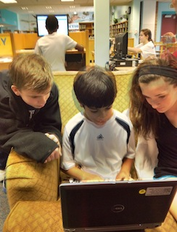
Teaching in the Middle Grades WEBINAR
You’ll find all the handouts and slides ~ and the webinar ARCHIVE ~ at this MiddleWeb page:
bit.ly/MWwebinar

