Slide 1
Instructions
This is for those who want to review or teach with visuals
You can copy and paste new pictures into the slides
Click on the orange bar to start the timer. (Bar fades to left - adjust the time in the Animation settings)
This is a review in which you can use premade answer cards (Legislative, Executive, Judicial)

Slide 2
The U.S. Constitution: Visual Review Game
Titles:
Branches:
Congress
President
Supreme Court
Legislative Branch
Executive Branch
Judicial Branch
You must be able to name the branch, title and at least one job performed by what each picture represents

Slide 4
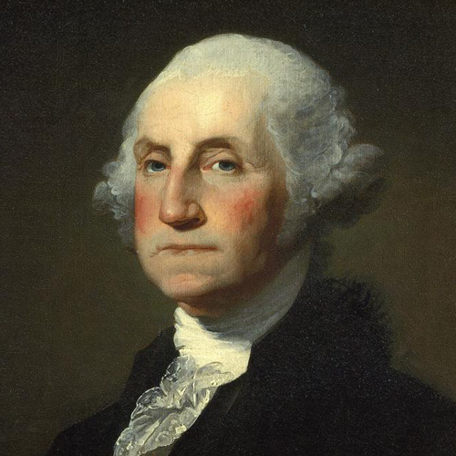

Slide 5
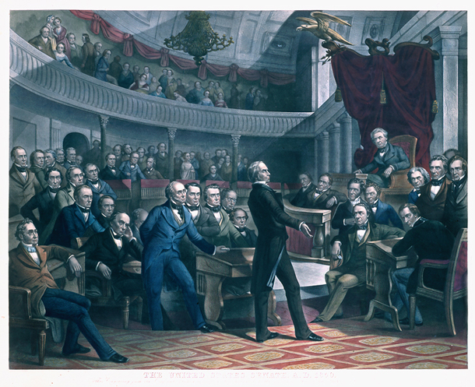

Slide 6
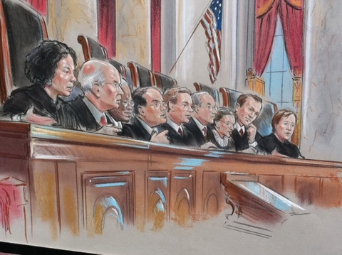

Slide 8
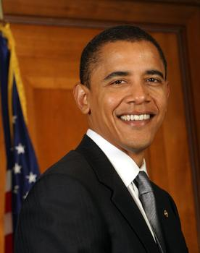

Slide 9
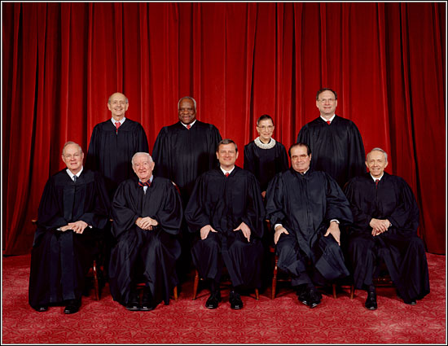

Slide 10
